Slide 1
Feature Importance Analysis for Purchase Prediction Using XGBoost and LightGBM
Name: N.Teja sri | Roll: 2520030139
Name: B.Hema sri | Roll: 2520030159

Slide 2
Abstract
Predicting customer purchase intent on e-commerce platforms is crucial for optimizing marketing, increasing engagement, and driving sales. This project builds a predictive purchase model using two gradient boosting algorithms: XGBoost and LightGBM, known for high accuracy and efficiency on large datasets. The process includes preprocessing (handling missing values, encoding, and normalization), model training, and performance evaluation using Accuracy, Precision, Recall, F1-Score and Confusion Matrices. A central focus is Feature Importance Analysis to identify key drivers such as product category, session duration, discounts, and past purchase behavior. This analysis enhances model transparency, helping businesses execute data-driven marketing, customer segmentation, and inventory planning.

Slide 3
Abstract (cont..)
The comparison between XGBoost and LightGBM highlights how feature importance insights assist in understanding complex customer preferences. By converting customer interactions into actionable predictions, the proposed system demonstrates the practical value of ensemble learning techniques in e-commerce applications. Ultimately, the study bridges statistical performance with business decision-making, ensuring both predictive power and model interpretability.

Slide 4
Problem Statement
To develop a machine learning system that predicts whether an e-commerce customer will purchase a product based on customer demographics, browsing behavior, product category, discounts, session duration, ratings, and previous purchase history, while identifying the most influential features using XGBoost and LightGBM

Slide 5
Dataset
Source: E-Commerce Customer Purchase Dataset (CSV format).
Type: Structured tabular data containing customer interactions, browsing behavior, product attributes, and target purchase status.
Features: Customer demographics, browsing history, product category, discounts, session duration, ratings, and previous purchase details.
Target: Purchase Decision (Binary Classification: Purchased / Not Purchased).

Slide 6
Existing System vs Modified System
Aspect | Existing System | Modified System (Proposed)
Algorithms | Logistic Regression, Decision Trees, Basic Random Forest | XGBoost & LightGBM
Model Interpretability | Low; basic feature weights or black-box predictions | High; feature importance ranking.
Processing Efficiency | Slower training speed on large-scale e-commerce datasets | Fast parallel processing & memory-efficient leaf-wise growth
Handling Complex Data | Struggles with high-dimensional non-linear features | Captures complex non-linear interactions across variables effectively
Primary Focus | Basic prediction outputs | High predictive performance combined with business interpretability

Slide 7
Expected Outcome
Feature Importance Ranking: Clear visual charts ranking top influential features (e.g., discounts, session length).
High Predictive Performance: Robust performance across Accuracy, Precision, Recall, F1-Score.
Comparative Insights: Performance comparison determining which gradient boosting framework is best suited for purchase prediction.
Business Application: Actionable insights enabling personalized recommendations and targeted marketing strategies.

Slide 8
Case Scenario
Case Scenario: E-Commerce Purchase Prediction
An e-commerce company wants to increase its sales by identifying customers who are likely to purchase a product. The company has customer interaction data such as session duration, product category, discount percentage, ratings, browsing history, and previous purchases.
The system analyzes this data and predicts whether the customer will Purchase or Not Purchase. XGBoost and LightGBM are used to build the prediction models, while feature importance analysis identifies the factors that have the greatest influence on purchase decisions.

Slide 9
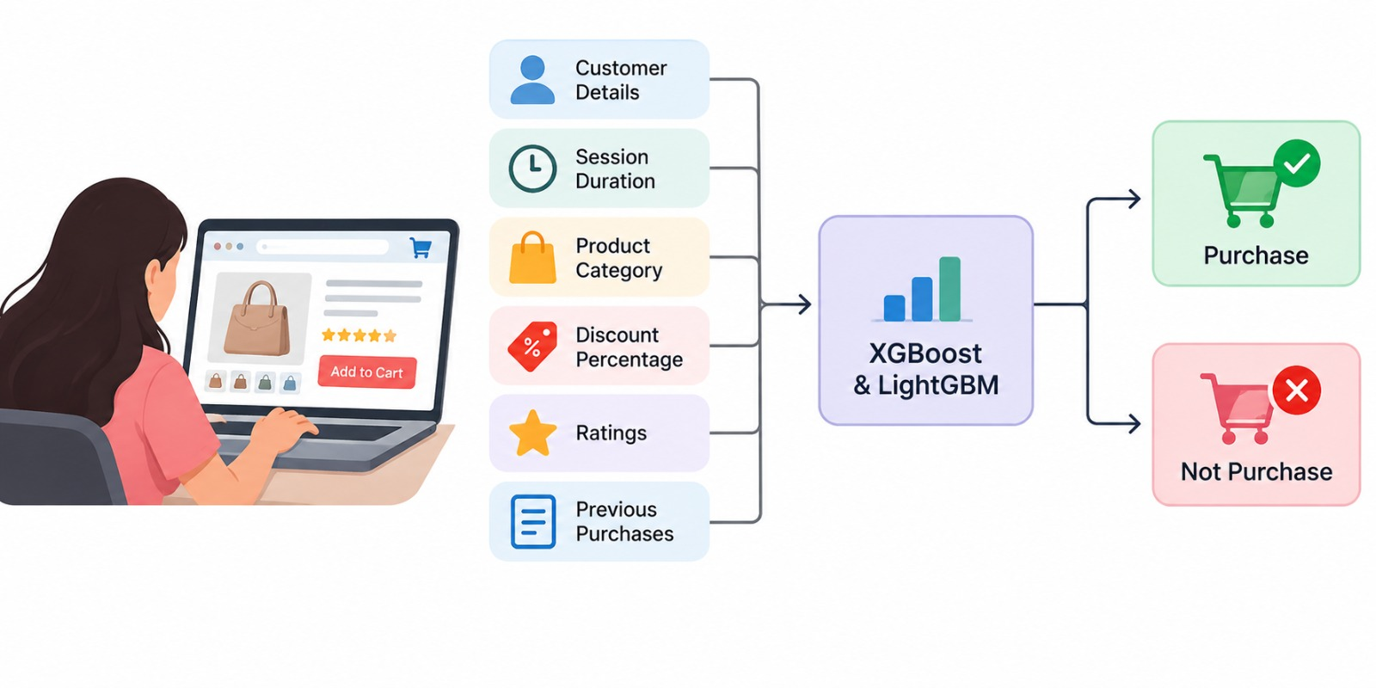
Implementation
Collect customer data, handle missing values, encode categorical features, and normalize data.
Exploratory Data Analysis – Study customer behavior, purchase patterns, discounts, and session duration.
Model Training – Train XGBoost and LightGBM models to predict purchase decisions.
Feature Importance Analysis – Identify the most influential factors affecting customer purchases.
Model Evaluation – Compare both models using Accuracy, Precision, Recall, F1-Score, and Confusion Matrix.
Prediction & Insights – Predict Purchased/Not Purchased and generate useful business insights.

Slide 10
Algorithm Demonstration
1. Data Preprocessing-Clean the dataset and convert customer information into suitable numerical features.
2. XGBoost Algorithm-Build multiple decision trees sequentially, where each new tree improves the errors of the previous trees
.3. LightGBM Algorithm-Use gradient boosting with efficient, leaf-wise tree growth to make predictions faster
4. Feature ImportanceCalculate and rank the features that contribute most to the purchase prediction.
5. Prediction & EvaluationPredict Purchased / Not Purchased and evaluate the models using Accuracy, Precision, Recall and F1-Score.
Implementation flow:Dataset → Preprocessing → XGBoost/LightGBM → Feature Importance → Prediction → Evaluation

Slide 11
Conclusion & Future Scope
Conclusion: XGBoost and LightGBM provide accurate purchase predictions while feature importance tools ensure model transparency for business decision-making.
Future Scope:
  Integrate real-time streaming data for live session purchase predictions.
  Apply deep learning frameworks.for non-linear tabular feature modeling.
  Deploy the pipeline as an interactive web API/dashboard for automated marketing decisions.

Slide 12
THANK YOU

